Slide 1

LINUX – FILE PERMISSIONS
Docente: Dott. Daniele Gobbo Modulo 3

Slide 2
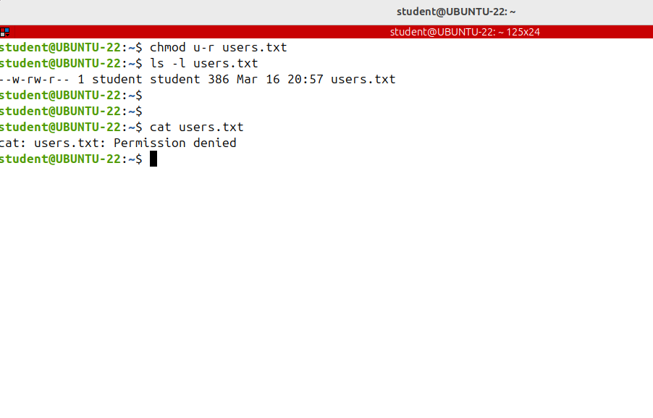
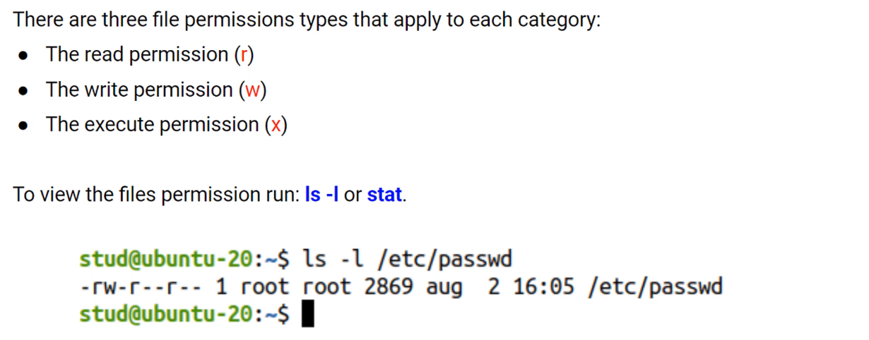
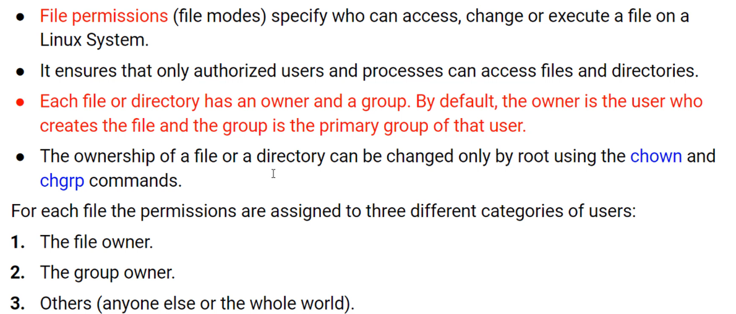
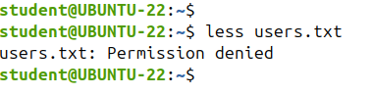
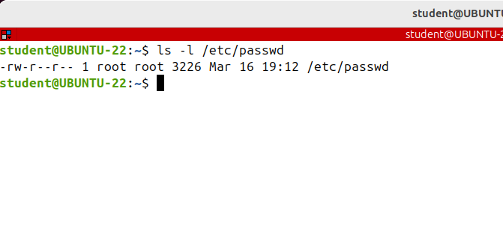
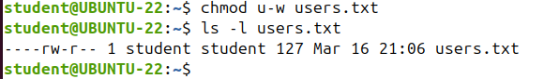
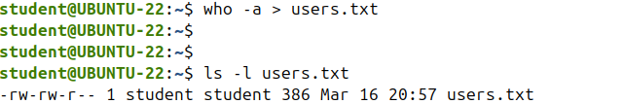
Understanding File Permissions
I'll exchange the file's permissions using the the chmod command but please don’t focus on the command.
I'll show you how to change the file's permissions and come back to the use of this command LATER.
I'm creating a file and then I want to see its permissions.
I'm using a redirection: users.txt and let's see the permission of the file.
The same rules are applicable to the group owner and the others categories.
Note that read and write permissions are not applicable to the root user, even though root does not have those permissions it can both view and change the files.
GROUP
PERMISSIONS
OWNER PERMISSIONS
EVERYBODY ELSE
PERMISSIONS

Slide 3
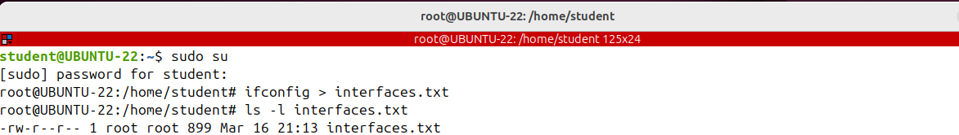
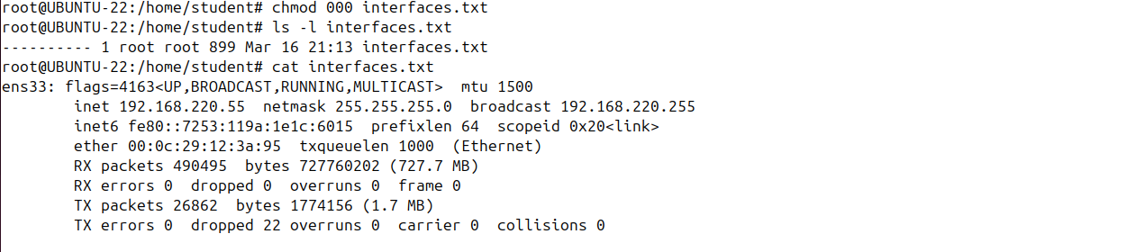
Understanding File Permissions
As the conclusion, we can say that the files read and write permissions are only for non privileged
users

Slide 4
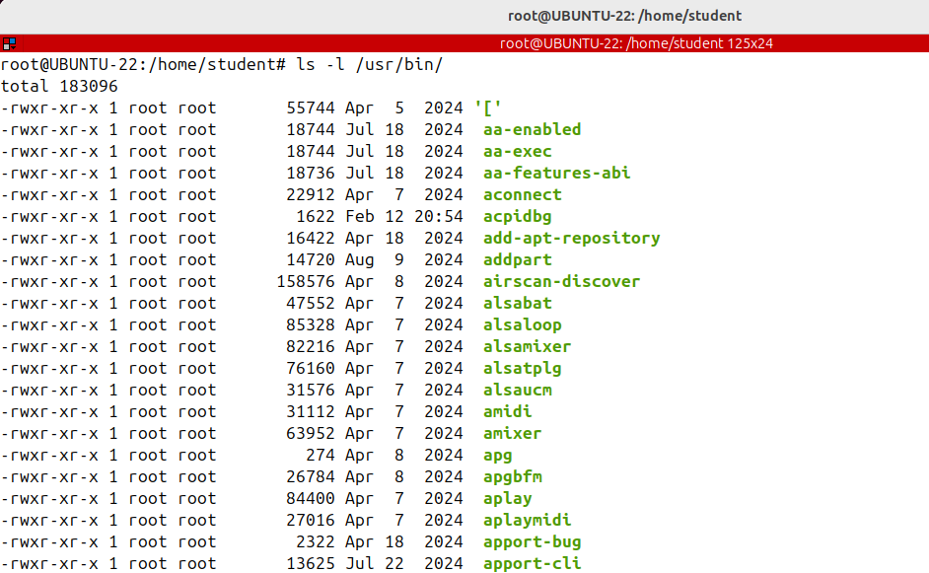
Understanding File Permissions
The last permission is execute.
A file which has this permission is a shell script or a command. All Linux commands have the execute permission set.
If a file which represents a command doesn't have the execute permission set, then it cannot be executed, it cannot be run.

Slide 5
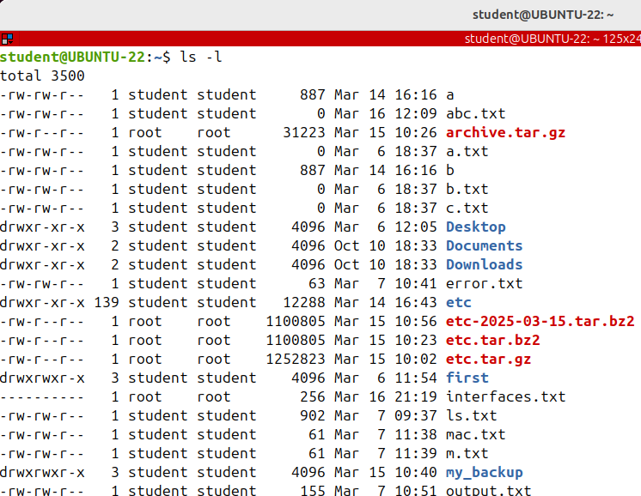
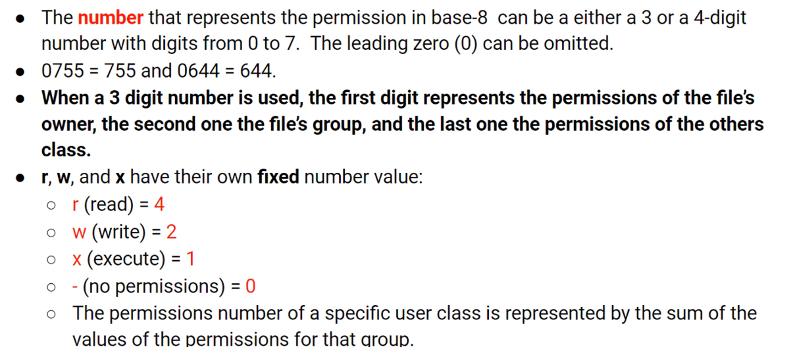
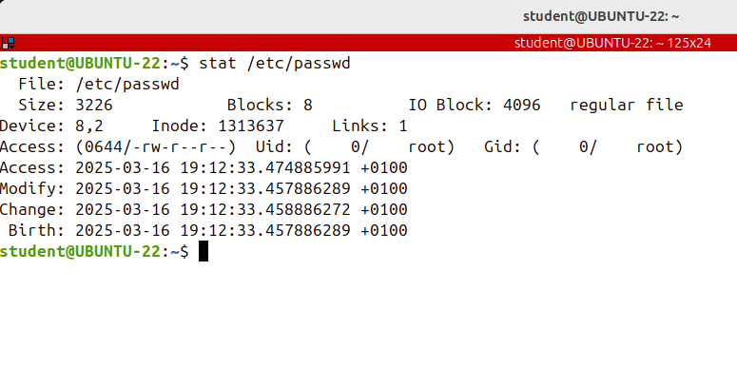
Octal (Numeric) Notation of File Permissions
The most common form of seeing the symbolic notation is to run the ls -l command.
Another method of representing Linux permissions is an is an octal or base-8 notation.

Slide 6
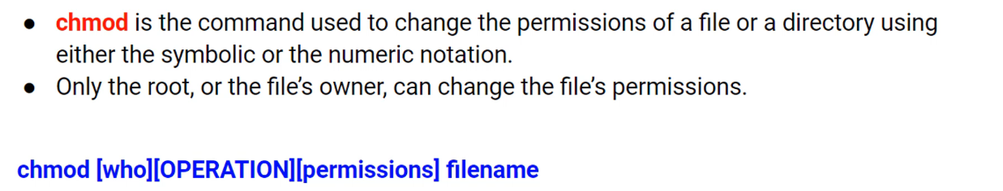
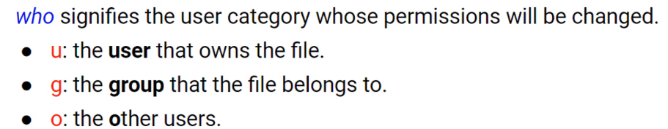
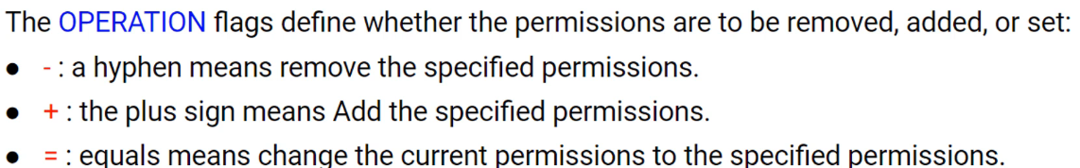
Changing File Permissions (chmod)

Slide 7
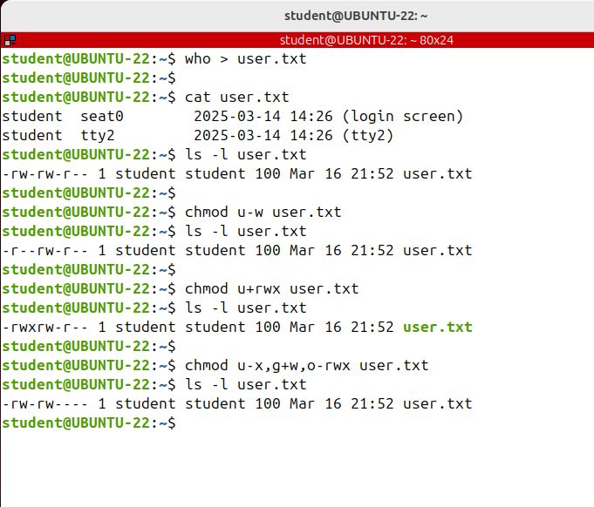
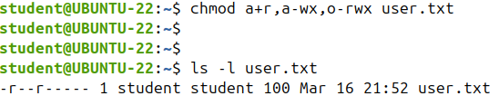
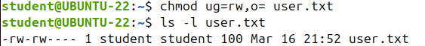
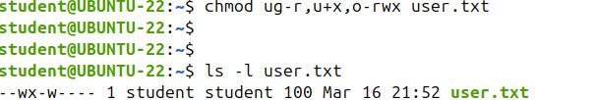
Changing File Permissions (chmod): EXAMPLES

Slide 8
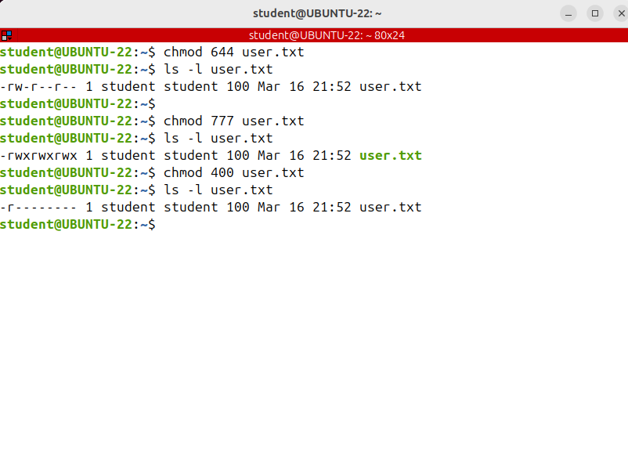
Changing File Permissions (chmod): EXAMPLES
Sometimes it's easier to change the permissions using the numeric method.
This is also known as the absolute changing mode because you set the permissions for all three user classes: owner, group and others at the same time.
In the next example, I'll give to the file’s owner the read and write permissions and only the read permission
to the group and all the other users:
chmod 644 and the file, I'm giving all permissions to all categories of users.

Slide 9
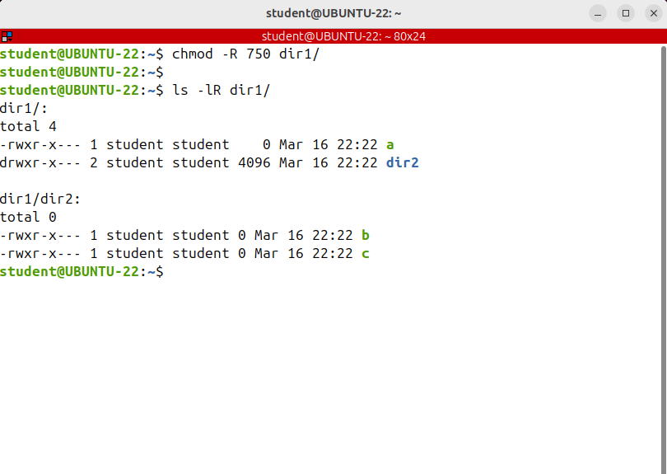
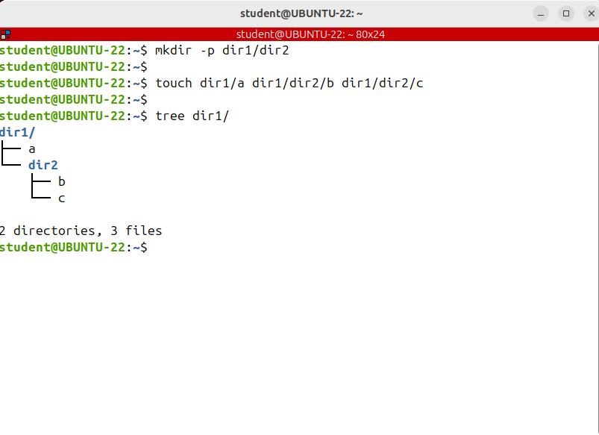
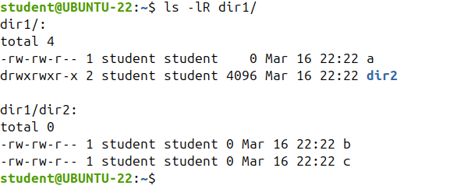
Changing File Permissions (chmod): EXAMPLES
To recursively operate on all files and directories under a given directory, use the R option, I'm creating a new directory structure with some directories and files inside.
I want to change the permissions of all files and subdirectories under the dir1 directory to 750
v

Slide 10
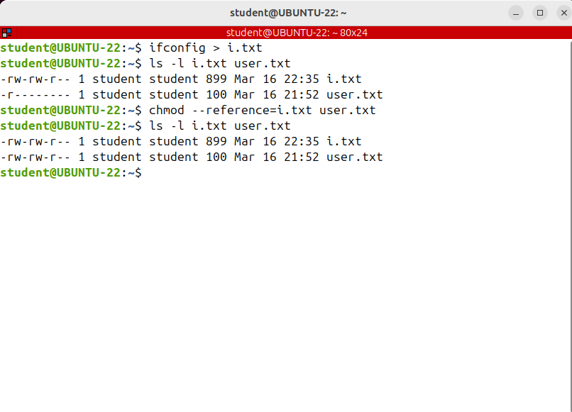
Changing File Permissions (chmod): EXAMPLES
We want to know how to set the file's permissions to be the same as those of a specified reference file

Slide 11
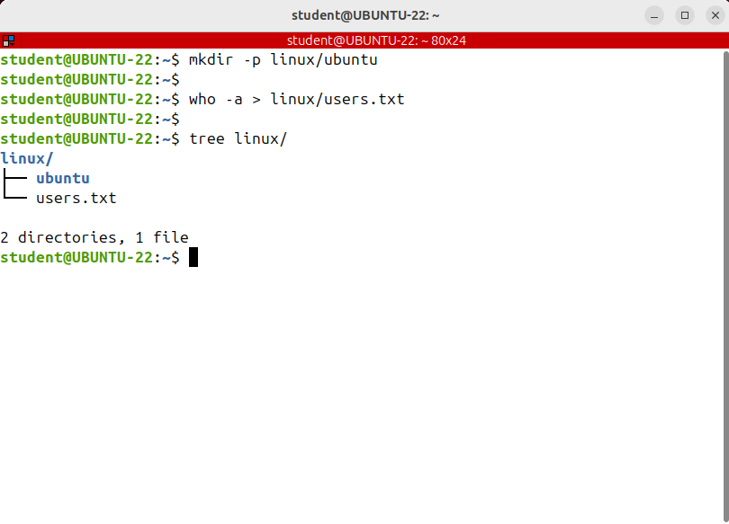
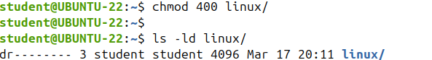
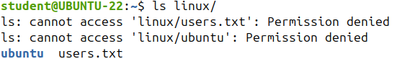
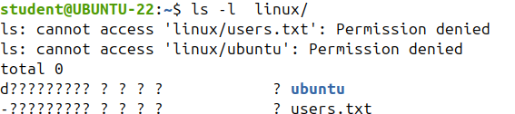
The Effect of Permissions on Directories
As you'll notice, the permissions on directories have a completely different effect as the permissions on files.
I'm going straight to the point with an example.
I'll sett only the read permission on the directory.
So the Linux directory has only the read permission set for the owner and the user I'm logged in as is the owner; let's try to list the contents of the directory. SURPRISE….

Slide 12
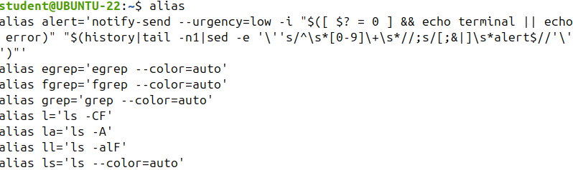
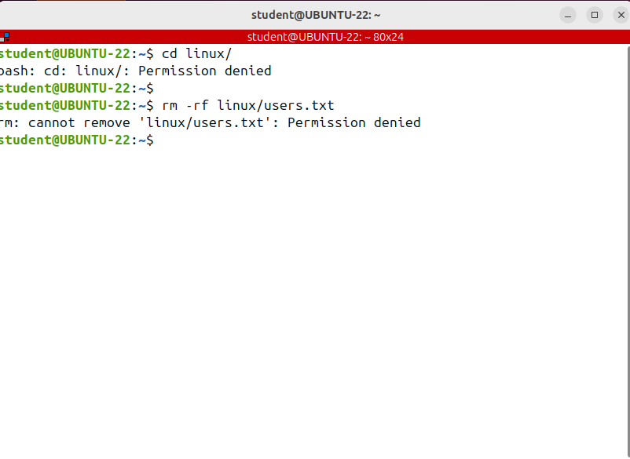

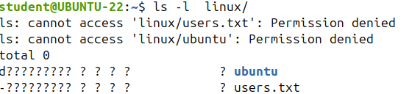
The Effect of Permissions on Directories
Imagine the directory as a glass box where you can see what's inside it, but you cannot touch it.
Now, if it read means showing the directory's contents, why did I get that error when I was running at ls -l
When you run ls -l the command tries to access the contents to see the type, permissions, owner and so on; and it's not allowed. The ls command was not allowed to read the contents of metadata. And when you run ls with no options, you run in fact an alias which is ls --color=auto.
The --color option tries to identify the file’s type to display its name and color based on its type.
For example, you see directories in blue and regular files in black, and that was not allowed.
This option was the problem.
I’m moving into the directory using cd.
And I can't, I am not allowed to enter the directory.
I'm trying to remove a file from the directory.
rm -rf linux and the file. As I'm the owner of the file
I should be able to remove it.
But surprise, I'm not allowed.
If instead of the alias I run the original ls command, and not the alias, by writing a
\ before its name, then I’ll get no error:
\ls and the directory name; note that you can rename the directory, that being allowed is you have the required permissions on its parent.
So the read permission on a directory only means that the directory can be shown by running ls.
It doesn't give you access to the contents of the directory.
That's why I couldn't remove the file or move into the directory.
I don't have access to the directorie's contents.

Slide 13
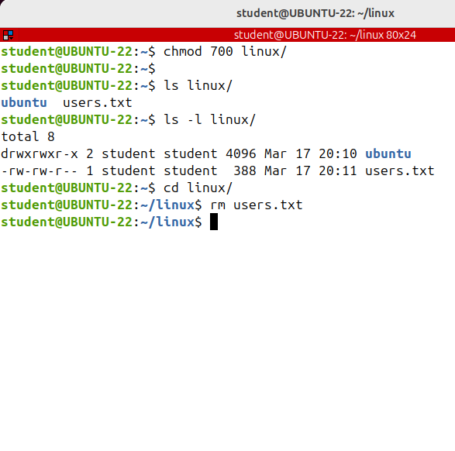
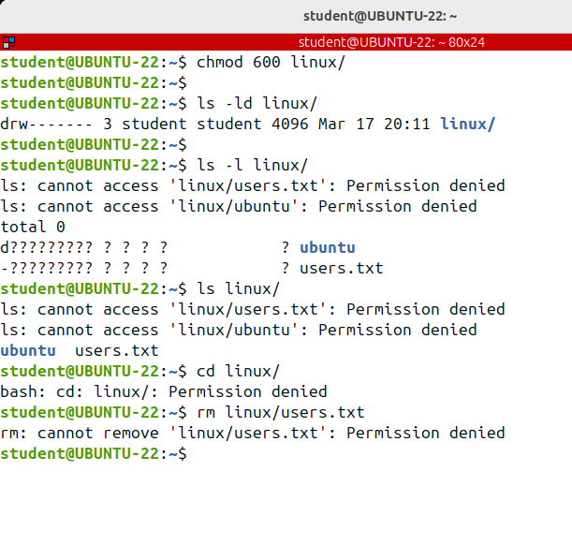
The Effect of Permissions on Directories
Let's add the write permission for the owner.
chmod 600 and the directories name.
Now, the owner has both read and write permissions.
And I'll try to do the same as before.
ls -ld linux ls linux; I can see the name of the files in the subdirectories, but no other information.
cd linux; I can't enter the directory.
rm linux users.txt
And I cannot remove or create files in the directory.
At first sight, it seems that the write permission didn't change a thing, and that's exactly so.
If the execute permission is not set, the write permission has no effect.
But if you set both write and execute write means that the directory's contents can be modified, create new files or subdirectories, rename or delete existing files or subdirectories.
So as a conclusion the write permission has effect only along with the execute permission; and finally, the execute permission on a directory means access to that directory's contacts.
I can move into the directory using cd
I can remove or create new files.
v

Slide 14
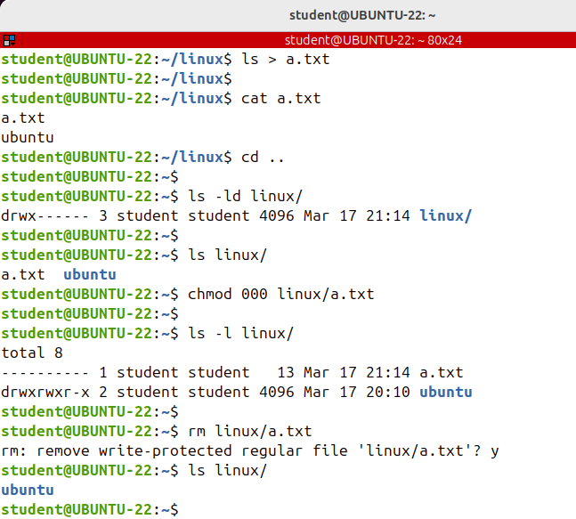
The Effect of Permissions on Directories
At the end, I have a question for you:
what will happen if a directory has all the permissions for a user's class but a file inside it has no permissions at all?
Could, for example, a user from that class remove the file?
v

Slide 15
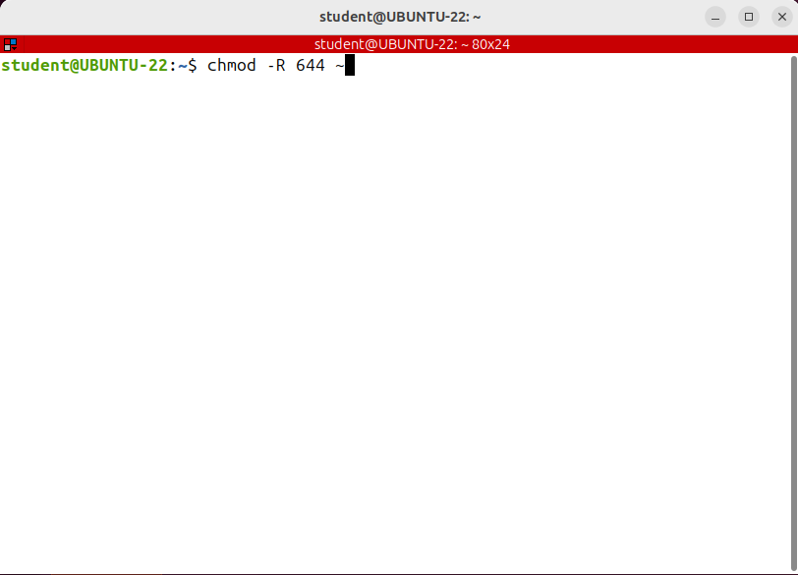
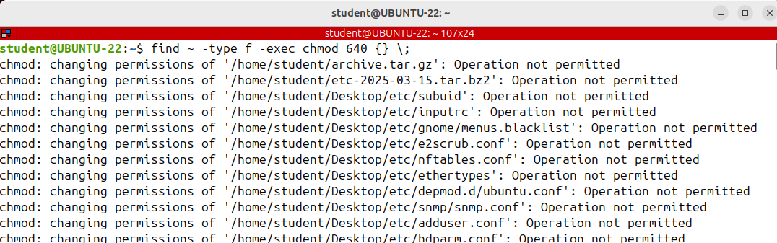
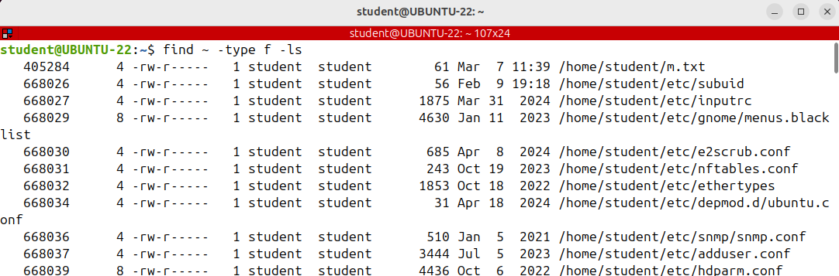
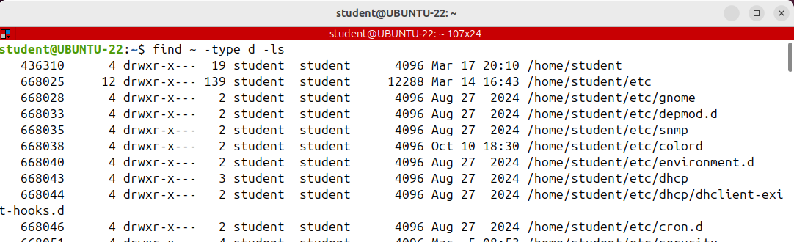
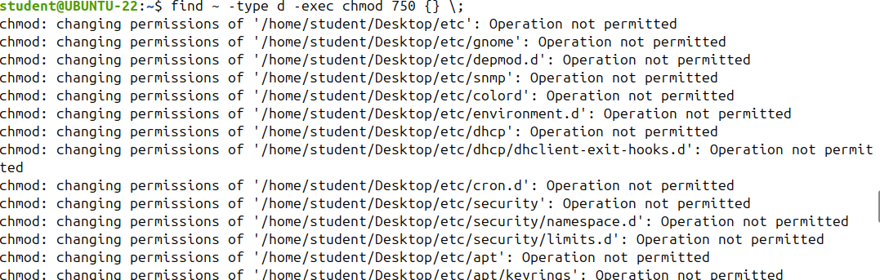
Combining Find and Chmod Commands
We've just seen that permissions have different effects on files and directories.
If you want to recursively set the permissions of all files to a specific value, then you should somehow exclude the directories in the path.
If not, the directories will have the same permissions as the files.
And this is not good.
Just imagine a directory that has only the read and write permissions.
It will be unusable.
It will change the permissions of both the files and the directories.
And I just wanted to change the files permissions.
The solution to this problem it is a very common one, is to combine, find and
chmod together.

Slide 16
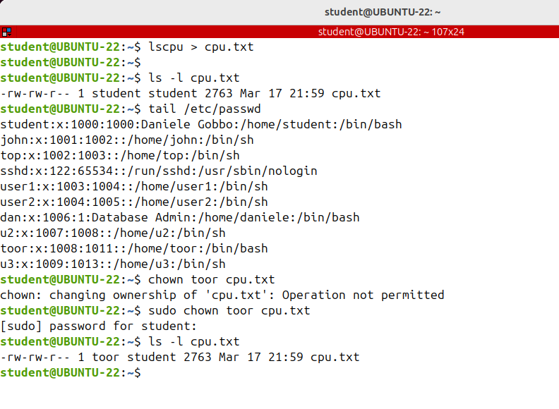
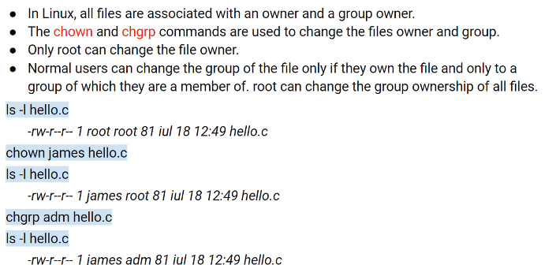
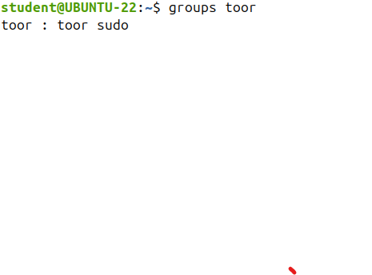
Changing File Ownership (chown, chgrp)
Remember that it's not mandatory for the owner of the file to be part of the group,owner of the same file. In this example, toor does not belong to the student group.
It belongs only to two groups toor and sudo
To change the owner of a file or a directory run the chown command followed by the user name of the new owner and the target file or directory as an argument.

Slide 17
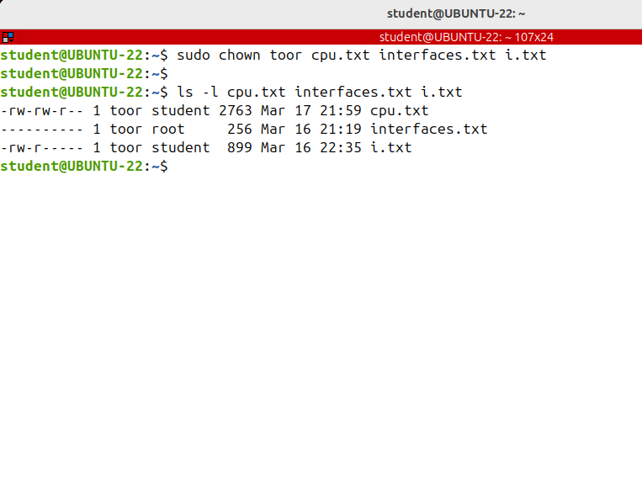
Changing File Ownership (chown, chgrp)
if you want to change the owner of more than one file, just specify the files as arguments to the chown command like this:

Slide 18
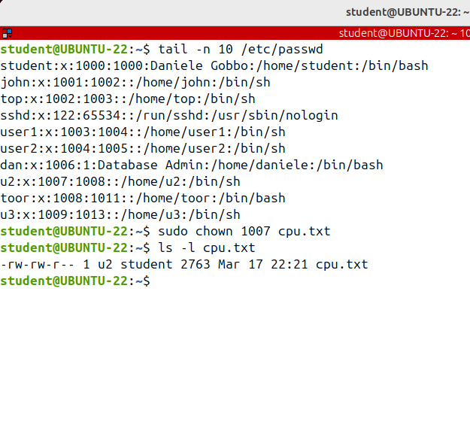
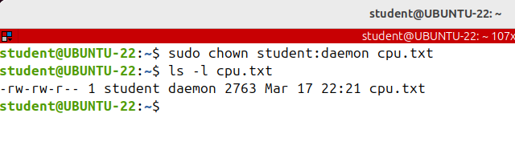
Changing File Ownership (chown, chgrp)
Also, the numeric user id can be used instead of the username.
Let's see a user ID.
For example, the user called the u2 has the user ID 1007 The following example will change the ownership of the file to a new owner with the user ID 1007.
The change owner command can be used to change both the owner and the group of a file ar the directory.
Just use a colon between the new owner and the group of the file,

Slide 19
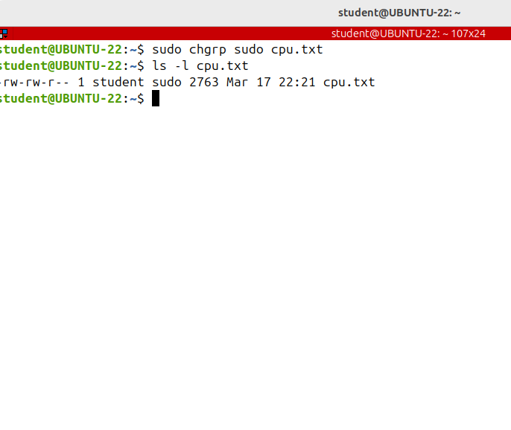
Changing File Ownership (chown, chgrp)
To change only the group ownership of a file or a directory, invoke the change group command or chgrp command followed by the new group name and then the target file or directory
as argument.For example I’m only changing the group of the cpu.txt file to sudo group:

Slide 20
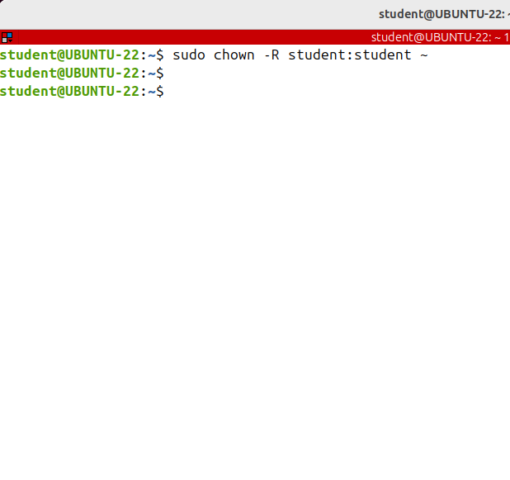
Changing File Ownership (chown, chgrp)
To recursively operate on all files and directories under a given directory use the capital R option. I'm changing both the owner and the group of all the files and directories in my home directory to my current user,

